Slide 1
YSM Program/Mission Chart of Accounts Guidance

Slide 2
Agenda
Introduction to Chart of Accounts
About Program
Program Hierarchy Definitions
Policy Tech
Difference between University’s Chart of Accounts (COA) Guidance and YSM Guidance
Mission Definitions & Examples
Key Takeaways – Program/Mission
Miscellaneous YSM COA Topics
YSM Balance Classification
COA Reminders
Related Resources
Questions & Support

Slide 3
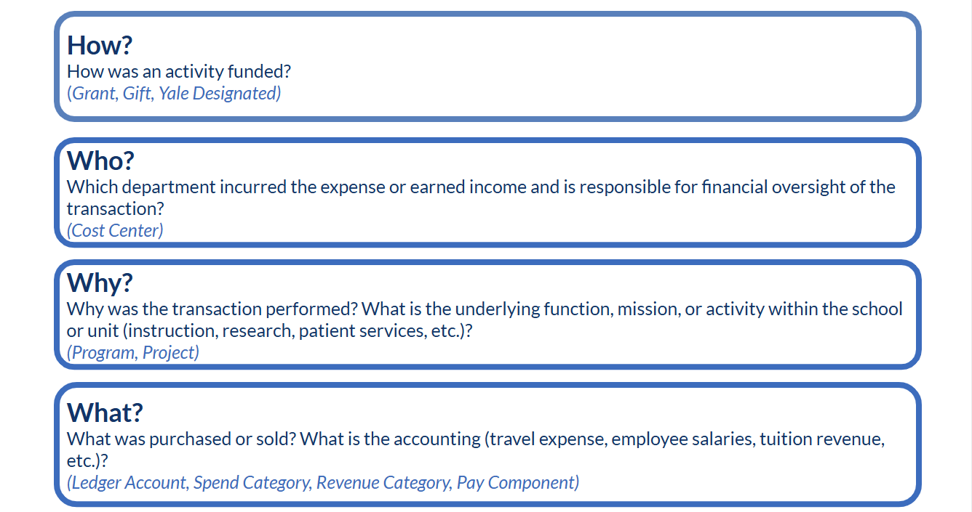
Introduction to Chart of Accounts
Yale’s Chart of Accounts (COA) is a set of codes used to classify and record financial transactions. The COA also provides the structure for reporting and monitoring financial activity at Yale

Slide 4
About Program
Program is a segment of the COA that is required on every transaction and rolls up to one of the University missions.
  YSM missions are Research, Education, Patient Care, Administration (with some rare exceptions)
The two top levels of the program hierarchy are "Mission" and "program Summary“ Activities are classified by their primary purpose or objective using the Program segment of the chart of accounts, not the funding source (grant, gift, YD) or the type of agreement.
To aid users in identifying the program summary rollup, each summary has been assigned a two-digit code such as (10) instruction or (21) research. These codes are listed in the program hierarchy definitions linked above and are present in the program name. e.g., PG00032 Research (21).
Notes:
As noted earlier, it is extremely important to have program be accurate at the Summary level of the hierarchy! The two top levels of the program hierarchy are “Mission” and “Program Summary”.

Slide 5
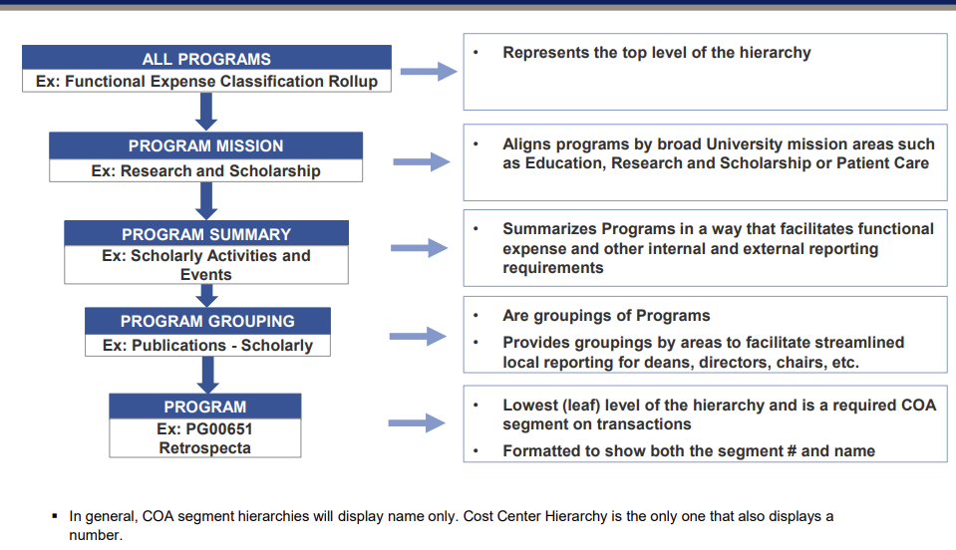
Example of Program Hierarchy
Program Hierarchy Definitions
Notes:
Programs also have a hierarchy – just one, though. The levels are shown here.
It is also used for Yale Officer, Dean and Director needs – reporting or “lines of business” or different missions within schools and units, and also to report consistently on activities that occur across many schools or units or across multiple cost centers within a school or unit.

Slide 6
About Program - continued
Program summary is important!
  Used to evaluate business operations
  Used to inform business decisions
  Program Mission is sometimes “line of business".
  Functional expense disclosures in the university’s annual report
  Expense presentation in the university’s Form 990 filing
  Programmatic reporting of expenses in the university’s IPEDS (Integrated Postsecondary Education System) filing with the Department of Education
  F&A rate calculation

Slide 7
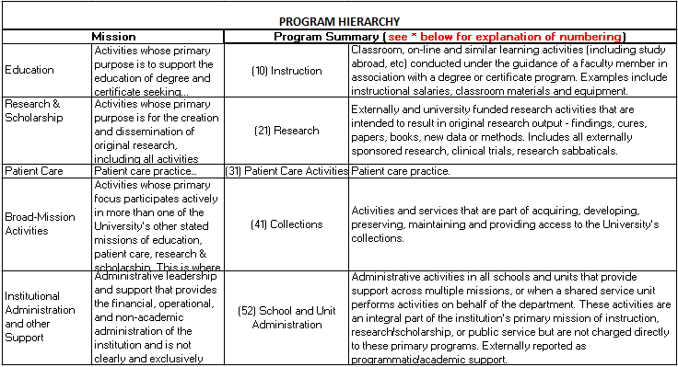
Program Hierarchy Definitions (examples)
See Program Hierarchy Definitions for detailed view of all 18 mission ID numbers.
See Program in Hierarchy View for full program list.
See YSM Recommended Program Usage – Reference for a limited list of programs to be used at YSM.
Notes:
Each program falls within a program hierarchy and mission. Here you will see a snippet of program mission IDs / or summaries with each of the 5 University missions. A definition is provided for each mission as well as for each program summary.
The program summary level of the program hierarchy is the higher level view, while the grouping level is the more detailed view if there are additional programmatic areas that branch off in a more granular way.
You can find more detailed information at the first two links to the University COA resources. The third link is limited list that shows only the programs to be used at YSM.

Slide 8
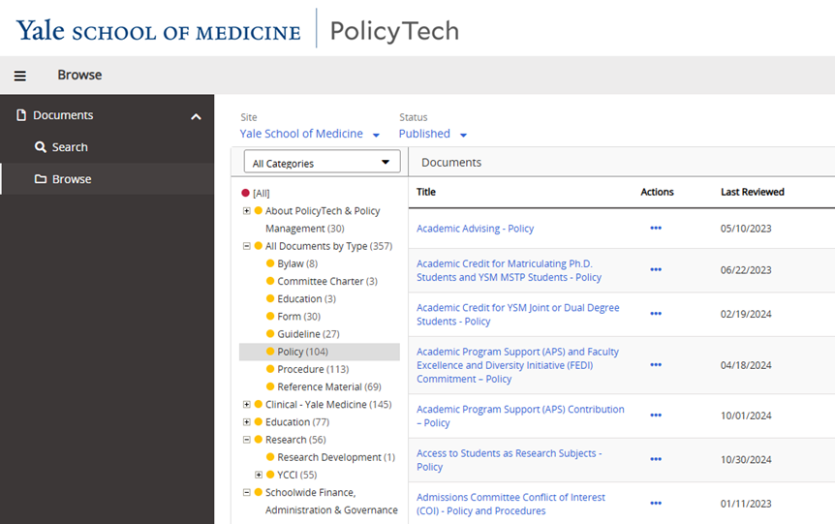
PolicyTech
Houses policies, procedures, guidelines, forms, and reference documents specific to YSM
  Many supplement Yale institution policies
Best access to the most up-to-date versions
To access PolicyTech, visit the PolicyTech Help page
  General FAQs
  General user training

Slide 9
What’s the Difference Between the University Guidance and YSM Guidance?
YSM Mission Coding – Guideline
YSM’s requirements are more specific and intended to supplement University guidance.
Only uses a subset of the available programs based on our activities and reporting needs.
Provides general YSM guidance for classifying direct revenue and expense transactions (before allocations) into the appropriate mission. This should be used in conjunction with the “YSM Recommended Programs” document which is a list of limited programs to be used at YSM.
Notes:
The following slides will provide an overview of program, but the University’s COA guidance includes many more details about this segment. For example, the relationship to external and internal leadership reporting requirements.

Slide 10
Mission Definitions & Examples - Research
Definition: Activities whose primary purpose is for the creation and dissemination of original research, including activities associated with externally funded research, scholarly publications, symposia, other scholarly activities and activities that directly enable research and scholarship of faculty.
Examples of activity that should be coded as research are:
Seminars
PhD activity
Graduate student supplements
Mentoring graduate students and post docs
Discretionary research including bridge funding
Academic Leaves can/should all be coded as research. Refer to the Academic Leaves – Procedure.
Most of our professorships, restricted Gifts and Endowments are intended for research, but coding should be in line with the specific restrictions of each.
Most grant and contract (“G&C”) activity is considered research*
*More information and examples of exceptions are in Section 2 YSM Mission Coding – Guideline
Notes:
Will walk through the missions used at YSM. This information is also detailed in the YSM Mission coding guidance document.

Slide 11
Mission Definitions & Examples - Education
Definition: Activities whose primary purpose is to support the education of degree and certificate seeking students, including activities that enable educational programs (e.g. admissions, registration, student information systems) and activities that directly support the student experience (e.g. advising, student life). Educational programs are for activities and costs that relate only to supporting individuals that Yale classifies as students, residents or fellows.
Examples of activity that should be coded as education are:
Teaching, lectures, discussion sections, etc. independent of funding.
Education leadership and education administration (e.g., course or clerkship director, Director of Graduate Studies “DGS”, etc.).
Resident/fellow leadership and support activity related to coordinators and leaders, but not the actual clinical or research time to teach.
Direct resident/fellow expenses with the exception of research electives
MD and other Master’s Program activity.

Slide 12
Mission Definitions & Examples – Education, cont.
Not considered education:
Academic time should not necessarily be coded as Education
PhD activity should be coded as research.
Grand Rounds, Continuing Medical Education (“CME”) and conferences teaching new clinical techniques to other teachers or clinicians would be clinical mission.

Slide 13
Mission Definitions & Examples – Patient Care
Definition: Patient Care practice, administration and support.
Examples of activity that should be coded as patient care are:
All fee-for-service revenues and expenses, including time spent with residents while in clinic.
Clinical contractual revenue and expenses including those related to Yale New Haven Health System (YNHHS) and the Veteran’s Affairs hospital, except those defined as Research or Education.
Grand Rounds, Continuing Medical Education (“CME”) and conferences teaching new clinical techniques to other teachers or clinicians.
Academic/protected time for Academic Clinician and Clinician Educator-Scholar track faculty
Effort for clinical staff such as clinic managers, medical assistants, LPNs and receptionists.
Effort and non-salary expenses related to coding and charge entry.
Notes:
Andy email/slides

Slide 14
Mission Definitions & Examples – Institutional Administration
Definition: Administrative leadership and support that provides the financial, operational, and non-academic administration of the institution and is not clearly and exclusively associated with a single university mission (e.g., research, education, patient care).
Activity should be coded to the appropriate mission when possible. Administration should not be used as a catch all. Refer to the Administrative Allocation – Procedure.
On a monthly basis, the YSM Controller’s Office allocates departmental administrative expenses net of internal revenue to each mission on LA91051. The amount to be allocated to each mission is calculated based on FTE’s.*
*Departments should not change/reallocate the distribution on LA91051
Notes:
Commonly referred to as “Admin” or “Administration”

Slide 15
Mission Definitions & Examples – Institutional Administration - continued
Examples of activity that should be coded as administration are:
Unrestricted Gifts and Endowments, those with a general purpose or those with an unclear donor intention, should be coded as administration regardless of how you need to use them (it is perfectly ok to cross fund your missions with unrestricted funds).
  Note: Professorships and all restricted Gifts or Endowments should be coded as indicated in the gift restrictions based on their intended use, keeping in mind that most of our restricted funds are intended for research.
Department Chairs, Section Chiefs and their Administrative Assistants should be charged to an administration program (to the extent these costs are not directly charged to another mission based on effort).

Slide 16
Mission Definitions & Examples – Institutional Administration - continued
Examples of activity that should be coded as administration are:
Effort for administrative staff and non-salary expenses related to recruitment, appointments and promotions should generally be charged to an administrative program.
Note: coding of Administrative Assistant salaries should generally follow the mission coding of the faculty they support.

Slide 17
Mission Definitions & Examples – Institutional Administration & Other Support - continued
Activities with Specific Programs:
Departmental human resources support should be charged to PG01098 Human Resource Activities - Local (52)
Distributed support providers (DSPs) and other IT support staff should be charged to PG00271 IT Support – Local (52), unless they are working explicitly on a specific research database or research project.
Effort for business office staff who are fully dedicated to a specific mission (i.e., 100% effort) must be directly charged to that mission (along with related non-salary expenses). Programs to be used for this activity are as follows:
  PG01706 – Business Office Operations - Local - Education 100% (12)
  PG01707 – Business Office Operations - Local - Research 100% (23)
  PG01708 – Business Office Operations - Local - Clinical 100% (32)
For business office staff members whose effort is split amongst two or more missions, the effort and related non-salary expenses must be charged to the business office program – PG00051 Business Office Operations - Local (52), unless directly supported by a grant. These expenses will then be allocated via the YSM Controller’s Office’s monthly journal entry as noted above. Examples of business office staff:
  Lead Administrator
  Operations Manager
  Pre and post award staff (charge to PG01707 for those supporting Research 100%)
  Financial Analyst
  Financial Assistant

Slide 18
Coding based on individual scenario
YSM Mission Coding – Guideline (Section 6)
Effort for Vice Chair for education/research/patient care role should be classified as education, research or patient care (over any amount charged to sponsored awards and YNHH for leadership role).
“Academic” time should be coded to reflect how the faculty spend their time (not how they are funded).
Administrative Assistants and support staff (other than those specifically noted above) should generally follow the mission coding of the faculty they support.
Faculty discretionary expenses should be charged to the predominant mission.

Slide 19
Key Takeaways – Program/Mission
Program usage and mission coding is important and is used for several highly visible business management activities and external reporting requirements.
YSM requirements are more specific than University guidance.
The definition for what should be coded to the Education mission is relatively narrow.
Programs in Administration should not be used as a catch-all.
There are multiple factors to consider when choosing the correct program such as:
  Mission
  Program Summary
  Program Grouping
  Program Name & Definition
  Limited list for use at YSM
Think you have an exceptional circumstance? Let’s talk!
Notes:
For the two units with approved exceptions for business office program usage, please review charging to all relevant BO programs.

Slide 20
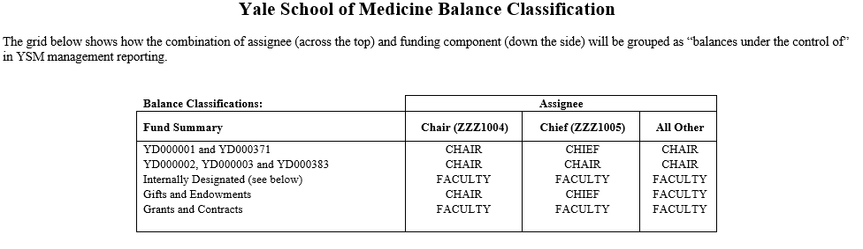
YSM Balance Classification
Ensure that financial activity and balances are appropriately classified as Chair, Chief or Faculty. This is accomplished by the combination of funding component and assignee.
See YSM Balance Classification - Reference for full grid.
YBT Reports that show this classification:
YSM50 SOA by Line of Business & Month
YSM56 SOA by Fund Summary – Chair Controlled Accounts

Slide 21
COA Reminders
Reminder - Revenue Categories and Program/Mission Should Agree
When requesting invoices via ysminvoicing@yale.edu, processing Cash Sales or providing instructions to Treasury on where revenue should be deposited, be sure the revenue category and program agree. Refer to Cash Sales COA – Reference.
For example:
  Clinical & Education Services Income (RC025) should only be used on a program that is in the clinical or education missions.
  Research Service Income (RC160) should only be used on a program in the research mission.
All YSM requests for new or revised COA segments must be submitted through the COA Intake Portal and will be routed to the YSM Controller’s Office for review and approval accordingly.
Do not use any COA segments that are marked “DNU”.
  DNU is an indication that the segment is earmarked for closure or deactivation in Workday.
Notes:
DNU – this is an indication that the segment is earmarked for closure or inactivation in Workday

Slide 22
Related Resources
Yale School of Medicine (YSM) COA Guidance
  YSM COA Guidance– various reference tools:
  YSM Mission Coding Guidance
  YSM Recommended Program Usage
  YSM Balance Classification
  Cash Sales COA guidance
  Workday Invoice Template
  Related Process: YSM Centralized Billing Process for Workday
University COA Guidance
  COA Information and Resources
  Program Guidance and Hierarchy Information
  Programs in Hierarchy View

