Slide 1
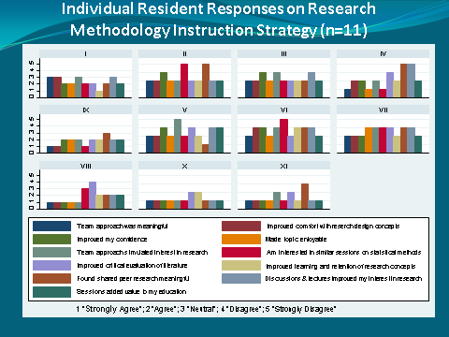
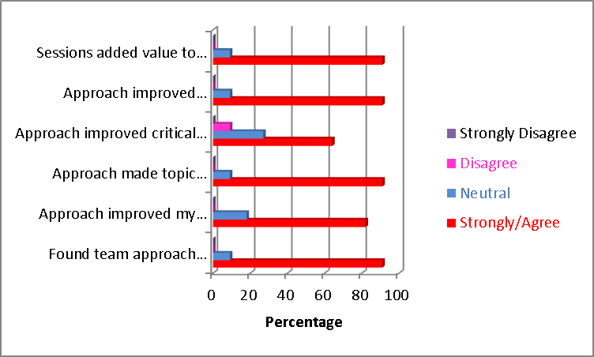
Team-Based Learning & Interactive Approach Foster Resident Engagement & Interest in Research Methodology & Concepts
Lubna Pal, MBBS, MRCOG, MSc, FACOG; Sangini Sheth, MD, MPH; Janice Crabtree, MS.
Department of Obstetrics, Gynecology & Reproductive Sciences , YSM
Introduction
Research methodology & concepts are an integral part of the Obstetrics & Gynecology Residency curriculum & residents are expected to be tested on basic concepts during the annual CREOG exam.
During Obstetrics & Gynecology Residency training at Yale, research methods & concepts have been traditionally conveyed through didactic sessions provided by departmental faculty with experience & expertise in clinical research.
Fig. 1
Fig. 2
Pedagogical Approach
Informal discussions with Resident trainees revealed:
Residents perceive their exposure to research concepts and methods as lacking in depth.
In the absence of opportunities to apply learned theories, research concepts conveyed through didactic sessions are perceived as short-lived.
Trainees unanimously acknowledged an interest in involvement with clinical research.
A majority of residents expressed an interest in a structured research curriculum to allow understanding of research methodology & wanted such exposure early in residency training period.
Discussions underscored a need for a structured research curriculum as well as a need for modification in teaching methodology so as to better engage the learner as an active participant in the learning process.
Fig. 3
Assessment
Resident feedback was obtained through:
11-item anonymized survey (Table 1) that was administered after completion of 1st hands-on workshop .
MedHub Evaluation of educational sessions will allow additional insight into trainee experience (to be compiled).
Reflections at end of session .
Hypothesis
Research concepts delivered through a combination of didactics, team-based learning activities, and subject review utilizing audience response system (ARS) will:
Be effective in engaging residents’ interest in the subject.
Generate enthusiasm for clinical research.
Foster development of critical thinking & analytic skills that will enhance ability to critically evaluate published literature.
Fig. 4
Objective
To pilot a research curriculum format for residents in Obstetrics & Gynecology that aims at delivery of basic concepts relating to clinical research & methodology through a combination of strategies that aim at engagement, interactive & team-based learning (Figure 1).
Conclusion
Results
Usefulness of ARS on learning outcomes and of team based learning in health professions is well recognized^{1,2}. Effectiveness of ARS approach for enhancing knowledge retention amongst Ob/Gyn residents has also been previously reported³.
A combination of didactics, interactive sessions, team-based learning, and incorporation of interactive sessions improved resident engagement in research-related concepts and made learning enjoyable.
Improved performance at standardized exams is anticipated and will be followed over the course of the next year; resident performance on statistics section of CREOG exam for 2015 will be compared with scores over past 3 years.
Residents’ protected time is being extended to allow interactive team-based learning opportunities starting in the next academic year.
Curriculum Inquiry & Curriculum Development
Data from resident survey following the first team based activity & workshop are presented.
The modified strategy that combined didactics with interactive methods & hands-on exercise on study design & approach (Figure 1) was deemed as meaningful, enjoyable & valuable to residents’ educational experience (Figures 2-4).
Peer evaluator identified the exercise as an effective strategy in engaging learners.
1/3rd of residents identified time constraints that limited their participation in team activities during out-of-class times.
Perspective on research curriculum & resident comfort with research concepts was obtained through informal discussions.
Review of existing research curriculum undertaken
ARS questions prepared based on information provided during didactic sessions (residents provided with lecture slides).
Hands-on team activity/workshop on concepts conveyed followed didactic sessions.
Peer reviewer was invited to assess trainee/faculty interactions and trainee enthusiasm during hands on exercise utilizing a modified version of an existing survey designed for peer evaluation of medical student educator (Hafler J).
References
Acknowledgements
Nelson Cody et al. The effects of ARS on learning outcomes in health professions education. A BEME systematic review. Med Teach 2012;34: e386-e405.
Mcmullen I et al. How we implement team-based learning for postgraduate doctors. Med Teach 2014; 36: 191-195
Pradhan A et al. The influence of an ARS on knowledge retention: an application to resident education. AJOG 2005; 193: 1827-30.
Special thanks to Drs. Janet Hafler and John Encandela for their invaluable input and guidance, to the Med Ed Fellows (2014) for the many intellectually stimulating and enriching discussions, and to the TLC Staff for a highly meaningful experience.

