Slide 1
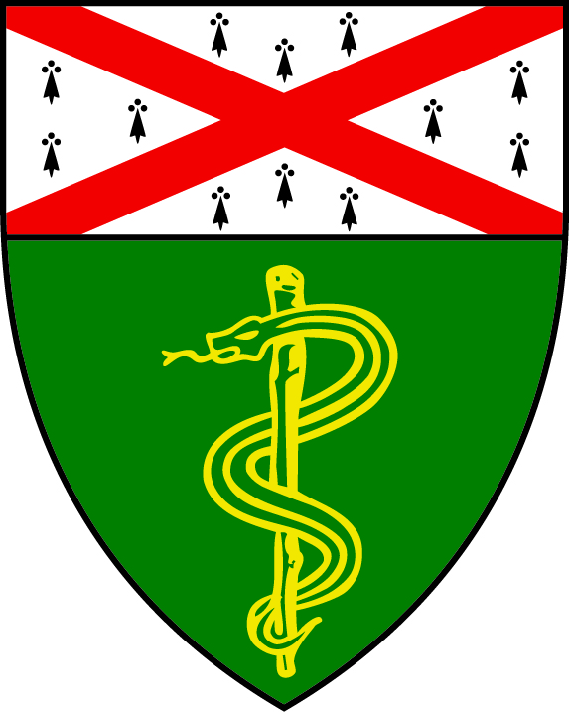
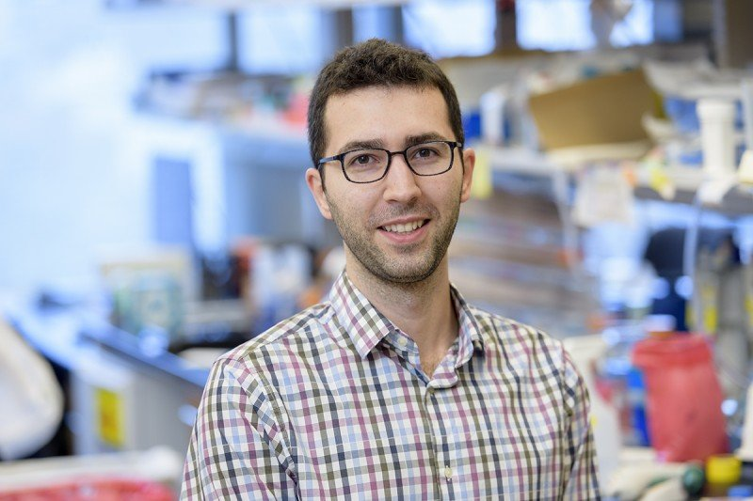
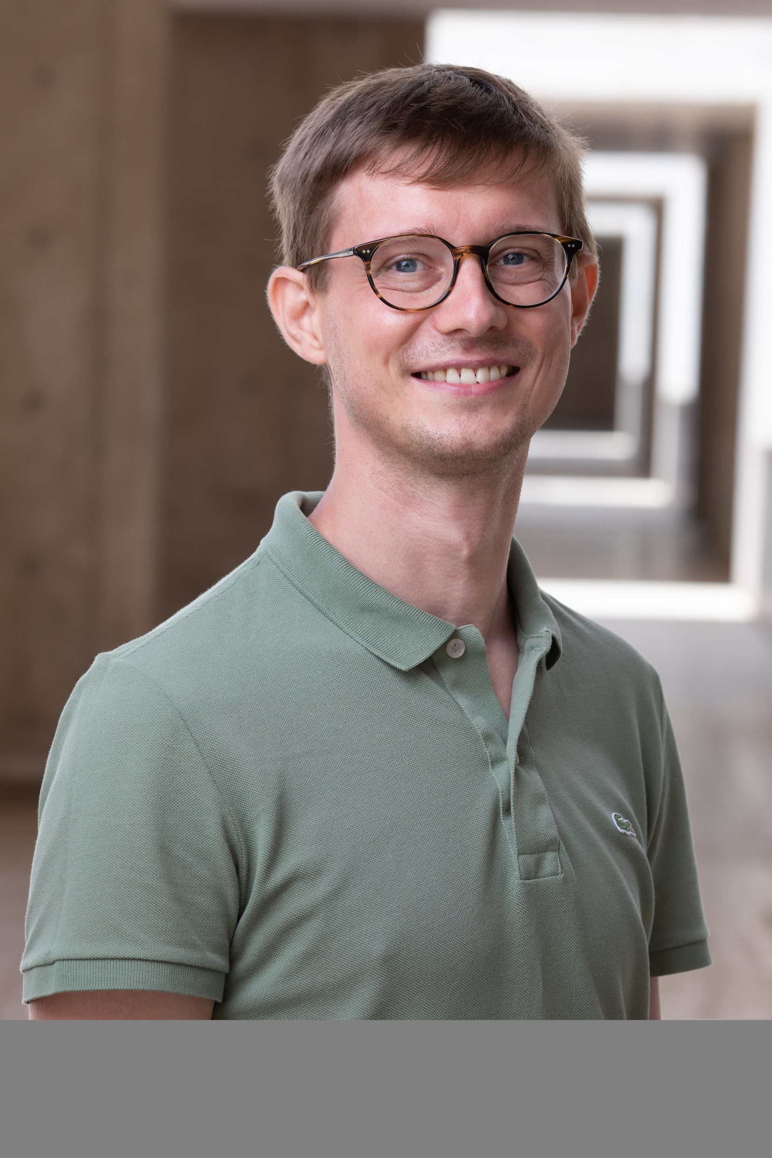
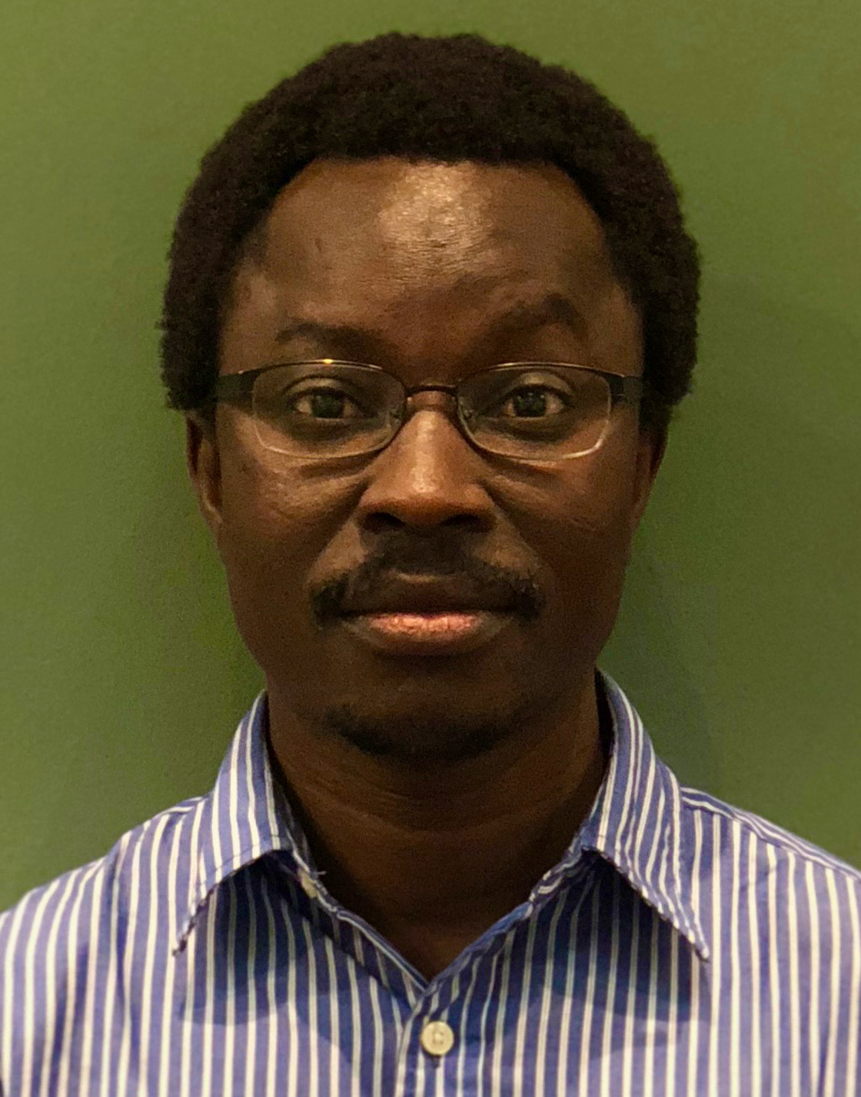
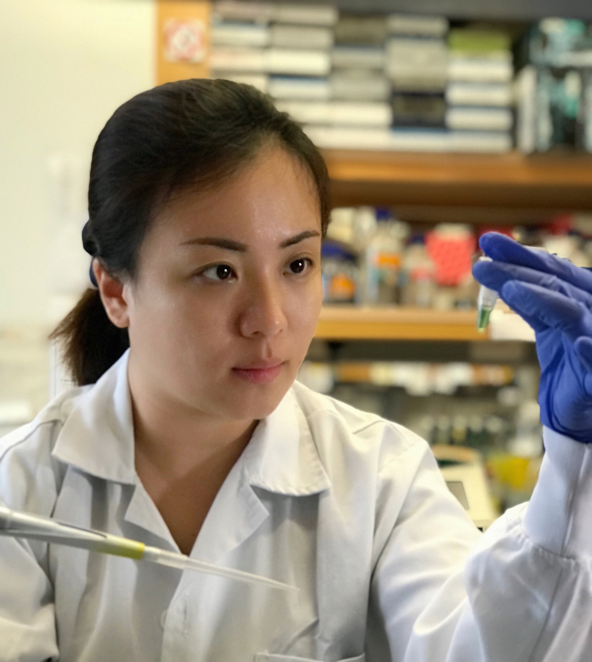
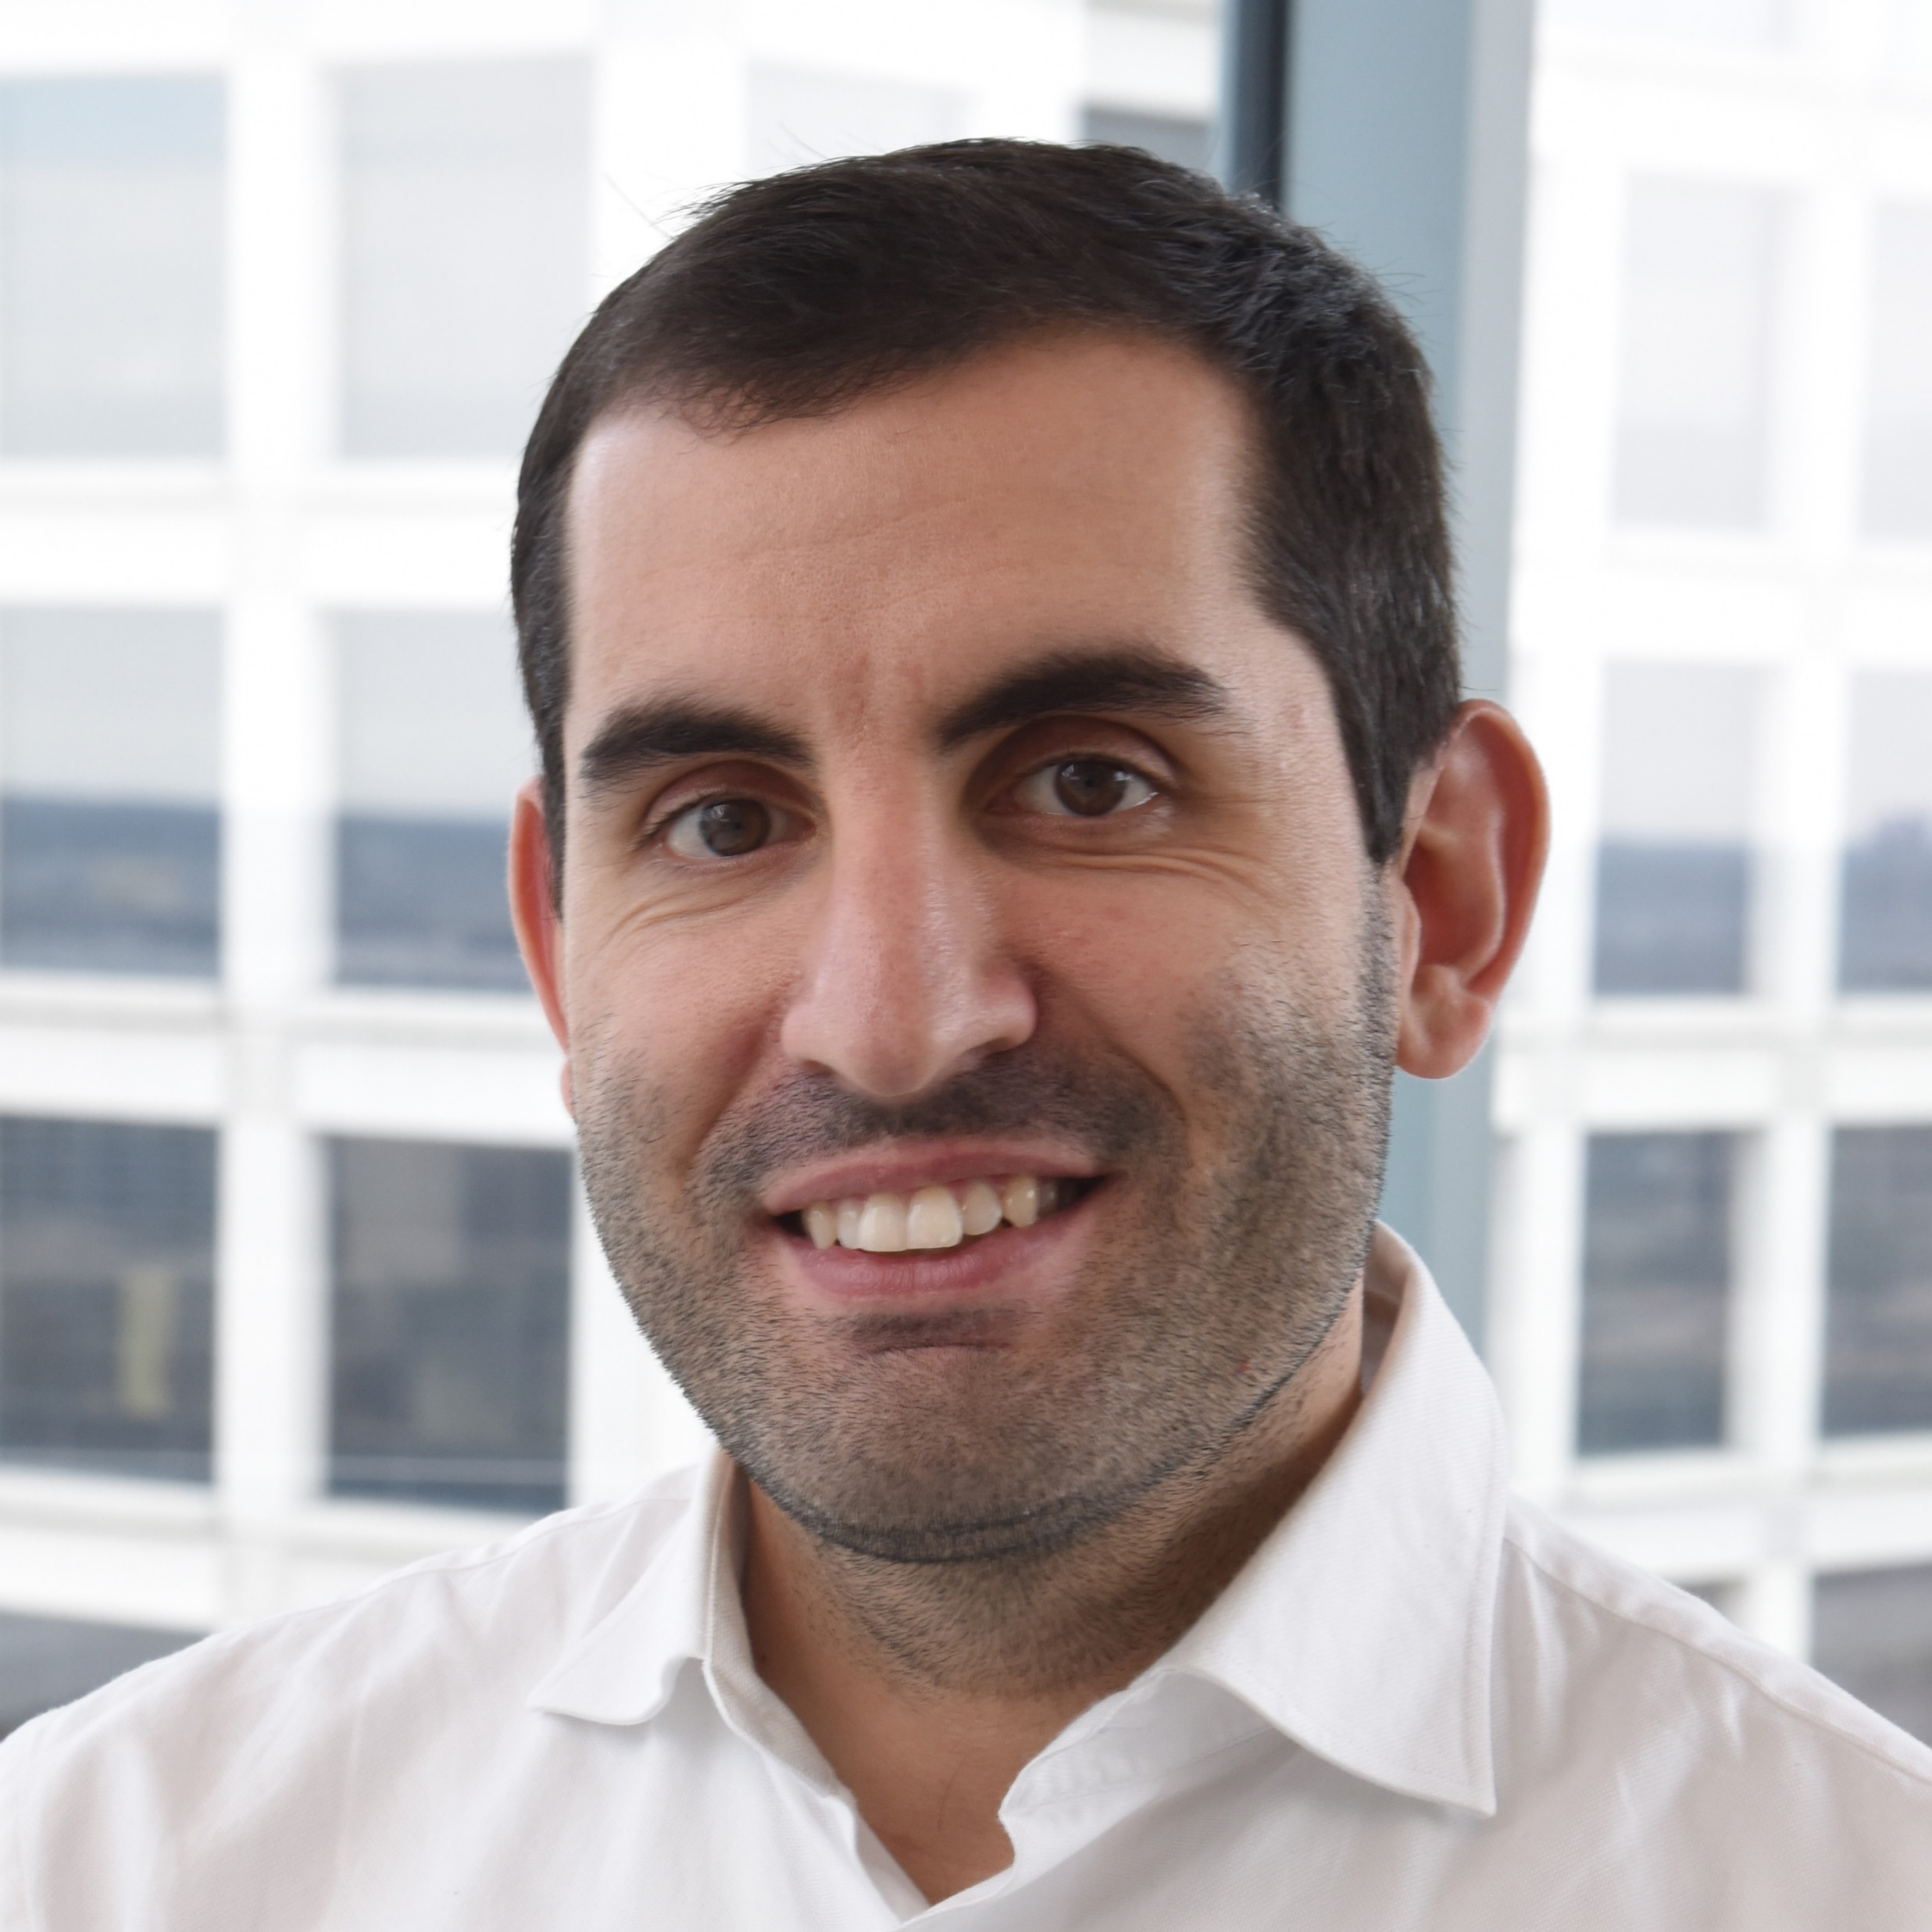
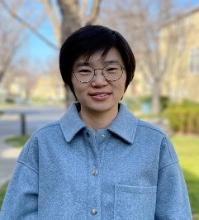
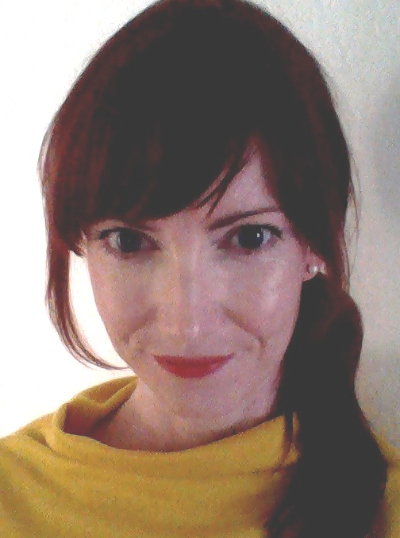
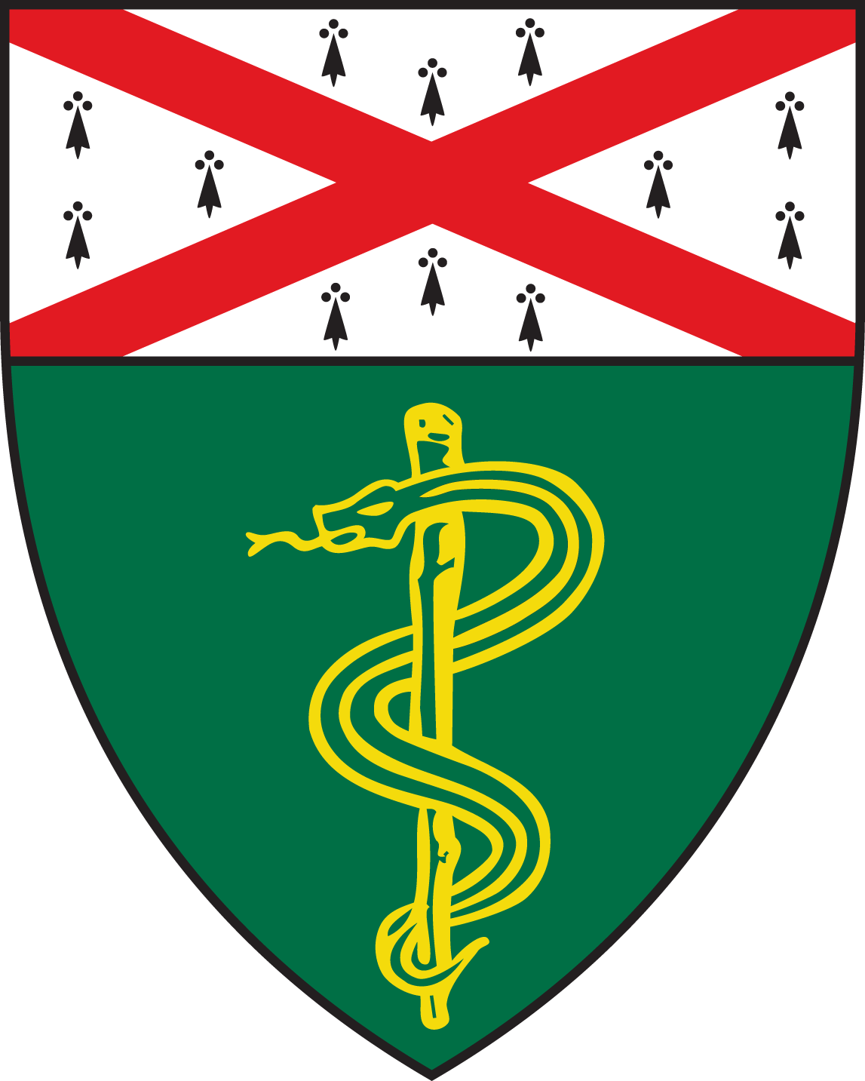
Yale Center for Molecular and Systems Metabolism (YMSM)
YMSM Faculty Candidates
November 2nd, 2022
9:00 am
Nehemiah Cox, PhD
Memorial Sloan Kettering
Cancer Center, Immunology
Program
November 18th, 2022
1:00 pm
Michal Handzlik, PhD
Salk Institute for Biological Studies
https://yale.zoom.us/j/99161445107
https://yale.zoom.us/j/92419312723
“Nutrient sensing by macrophages controls energy storage in metazoans”
"Interrogation of amino acid metabolism in metabolic disorders"
November 3rd, 2022
9:00 am
David Alagpulinsa, PhD
MGH & Harvard Medical School
November 21^{st,} 2022
9:00 am
Dan Xu, PhD
Duke-NUS Medical School, Singapore
https://yale.zoom.us/j/94729959646
https://yale.zoom.us/j/95090849336
"Pathophysiology and treatment strategies for
type 1 diabetes”
“RNA regulatory networks in fat”
November 7th, 2022
11:00am
Stefano Commazzetto, PhD
UT Southwestern Medical Center
November 22nd 2022
9:00am
Xiaoai Zhao, MD, PhD
Stanford University
https://yale.zoom.us/j/98552598263
https://yale.zoom.us/j/91291640514
“Dietary regulation of self-renewal and somatic mosaicism in hematopoiesis”
"Functional contribution of complex lipids in the neurogenic niche of the aging brain"
November 10th, 2022
12:00pm
Jennifer Beshel, PhD
Loyola University Chicago
https://yale.zoom.us/j/93715076278
“Energy balance regulation in the modern age: Clues from an age-old circuit”
Contact: Anton Bennett (anton.bennett@yale.edu)

