Slide 1
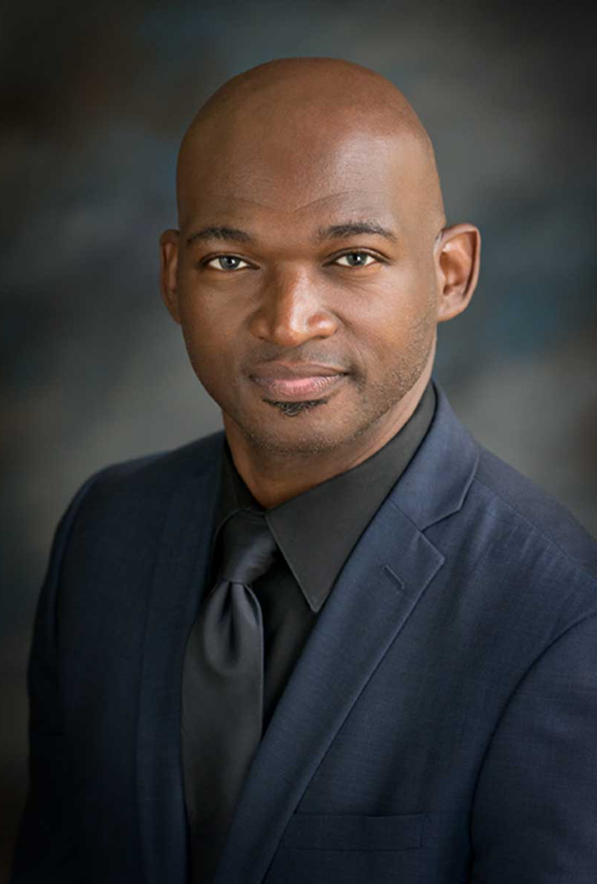
Karriem S. Watson, DHS, MS, MPH All of Us Research Program Chief Engagement Officer
Dr. Karriem S. Watson, DHS, MS, MPH, is the Chief Engagement Officer of the National Institutes of Health’s All of Us Research (AoU) Program. Karriem leads the All of Us Research Program’s efforts to foster relationships with participants, communities, researchers, and providers across the U.S. to help build one of the largest, most diverse health databases of its kind to study health and illness.
Prior to joining the NIH, Karriem spent over 15 years as a community engaged research scientists with prior research funding from the NIH addressing cancer prevention and control. Karriem also held administrative roles in leading research and engagement in Federally Qualified Health Centers (FQHCs) in the Chicagoland area.

